Slide 1
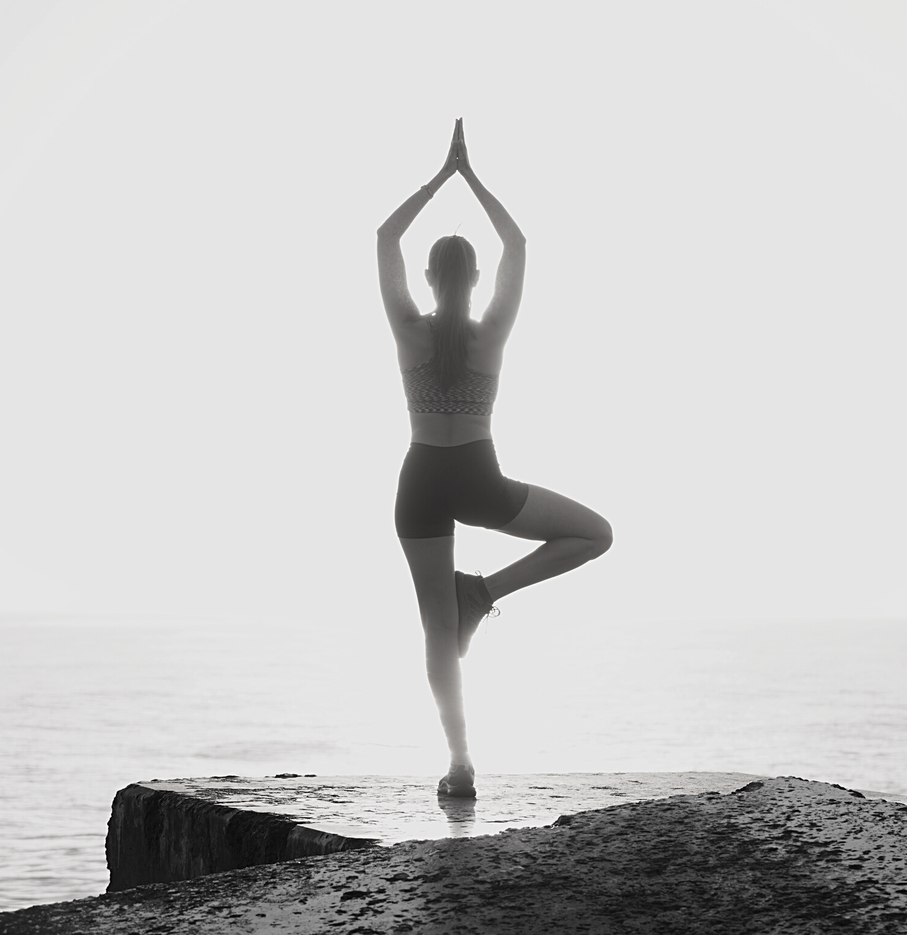

AI Based
Yoga guru
Shiwani Dembla
Sukkur IBA University

Slide 2


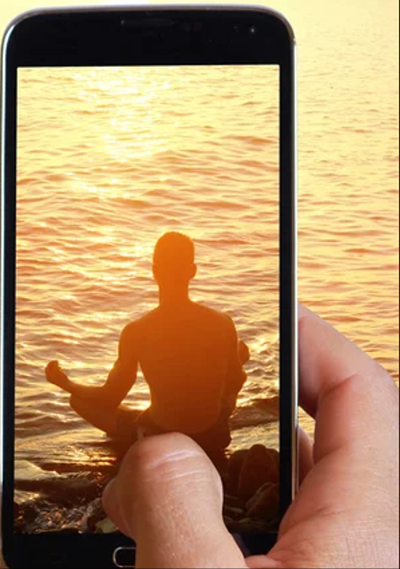
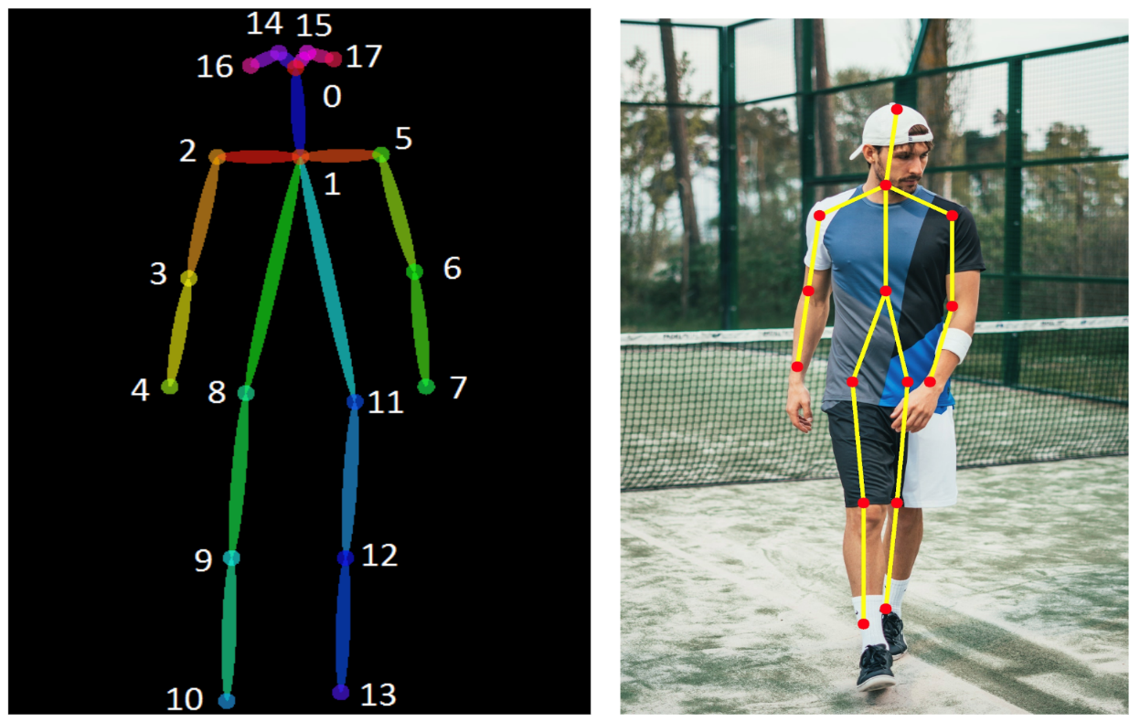
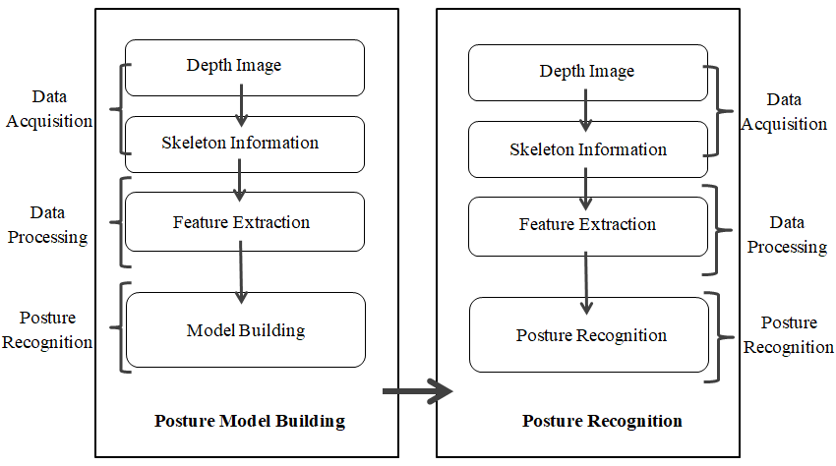
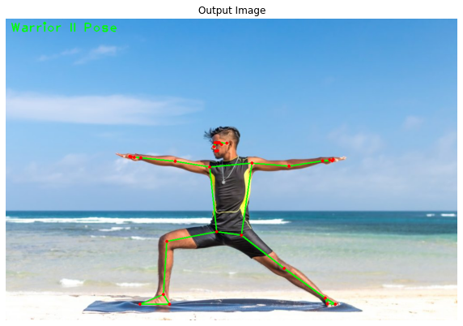
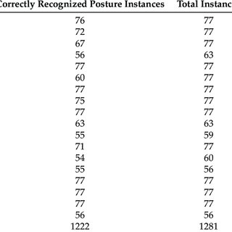
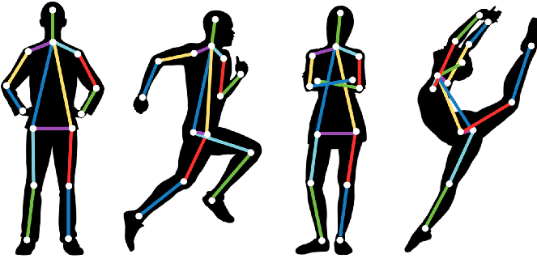
AI Based Yoga guru
Take live image input of Yoga pose from mobile phone
Body parts are detected in 17 points forming a skeleton of different colors
Using feature extraction and estimation, model recognizes the Yoga pose
Input pose is compared with Standard poses and Cosine Similarity is calculated
Final result guiding to set the pose.
Results of Model accuracy

